Slide 1
Introduction to Data Visualization
Data Visualization Course – Lecture 1
Artificial Intelligence
Mr. Ali Haider
Institute Of Management Sciences
Dr. Muhammad Sajjad
R.A: Imran Nawar
September 2024

Slide 2
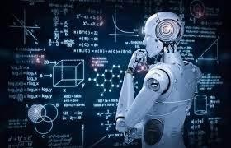
What is Machine Learning?
“Learning is any process by which a system improves performance from experience.” -
Herbert Alexander Simon
Machine learning is a subfield of artificial intelligence (AI) that focuses on the development of algorithms and statistical models that enable computers to learn and make predictions or decisions without being explicitly programmed for a specific task.
Machine learning is a major application of artificial intelligence (AI) that provides systems the ability to automatically learn and improve from experience without being explicitly programmed.
ML Definition by Tom Mitchell (1998): Machine Learning is the study of algorithms that
improve their performance P
at some task T
with experience E.
A well-defined learning task is given by <P, T, E>.

Slide 3
What is Machine Learning?
Traditional Programming
Data Program
Computer
Output
Machine Learning
Data Output
Computer
Program

Slide 4
What is Machine Learning?
Learning from Data:
At the core of machine learning is the idea of learning from data. Instead of following traditional rule-based programming, where a computer is given explicit instructions to perform a task, machine learning systems learn patterns and relationships in data to make predictions or decisions.
Data Input:
Machine learning algorithms require data as input. This data can come in various forms, including text, images, numbers, or any other structured or unstructured data. The quality and quantity of data play a significant role in the effectiveness of machine learning models.
Training:
To train a machine learning model, you need labeled data, which means the data is paired with the correct outcomes or labels. The model uses this labeled data to learn patterns and relationships. During training, the model adjusts its internal parameters to minimize the difference between its predictions and the actual labels.
Generalization:
The ultimate goal of machine learning is to create models that can generalize well to new, unseen data. This means that the model should be able to make accurate predictions or decisions on data it hasn't encountered during training.

Slide 5
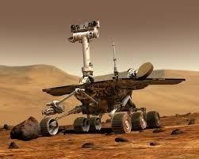
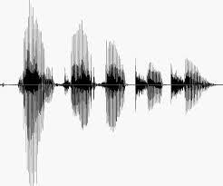
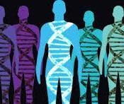
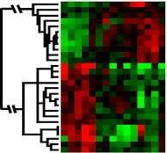
When Do We Use Machine Learning?
ML is used when:
Human expertise does not exist (navigating on Mars)
Humans can’t explain their expertise (speech recognition)
Models must be customized (personalized medicine)
Models are based on huge amounts of data (genomics)

Slide 6
Some more examples of tasks that are best solved by using a learning algorithm
Recognizing patterns:
Facial identities or facial expressions
Handwritten or spoken words
Medical images
Generating patterns:
Generating images or motion sequences
Recognizing anomalies:
Unusual credit card transactions
Unusual patterns of sensor readings in a nuclear power plant
Prediction:
Future stock prices or currency exchange rates

Slide 7
Sample Applications
Web search
Computational biology
Finance
E-commerce
Space exploration
Robotics
Information extraction
Social networks
Debugging software
[Your favorite area]

Slide 8
Defining the Learning Task
Improve on task T, with respect to performance metric P, based on experience E
T: Playing checkers
P: Percentage of games won against an arbitrary opponent E: Playing practice games against itself
T: Recognizing hand-written words
P: Percentage of words correctly classified
E: Database of human-labeled images of handwritten words
T: Driving on four-lane highways using vision sensors
P: Average distance traveled before a human-judged error
E: A sequence of images and steering commands recorded while observing a human driver.
T: Categorize email messages as spam or legitimate. P: Percentage of email messages correctly
classified. E: Database of emails, some with human-given labels

Slide 9
State of the Art Applications of
Machine Learning
11

Slide 10
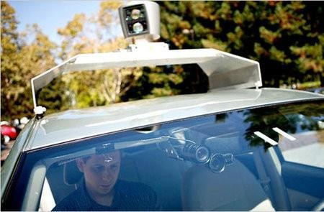
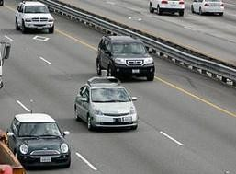
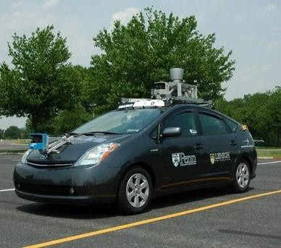
Autonomous Cars
Nevada made it legal for autonomous cars to drive on roads in June 2011
As of 2013, four states (Nevada, Florida, California, and Michigan) have legalized autonomous cars
Penn’s Autonomous Car ➔
(Ben Franklin Racing Team)
12

Slide 11
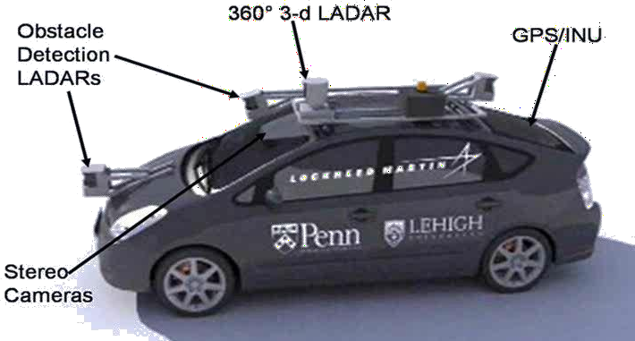
Autonomous Car Sensors
13

Slide 12
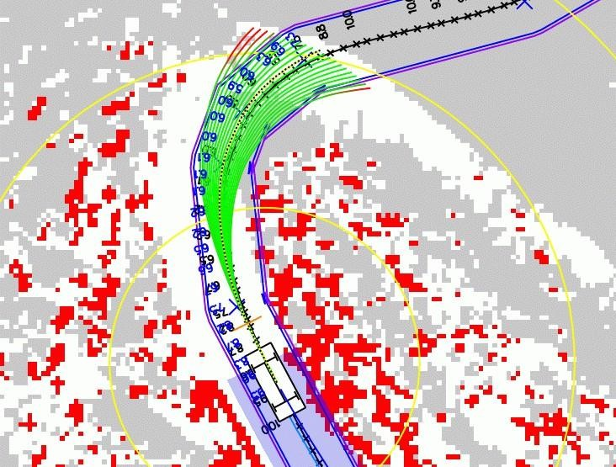
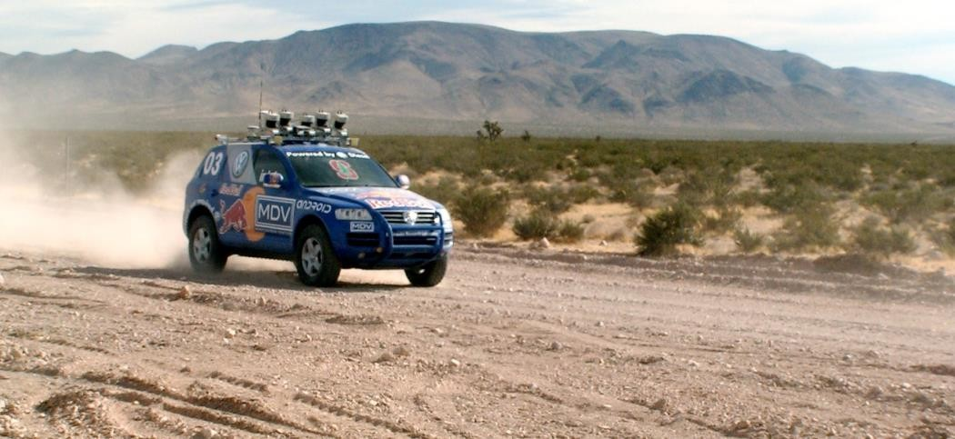
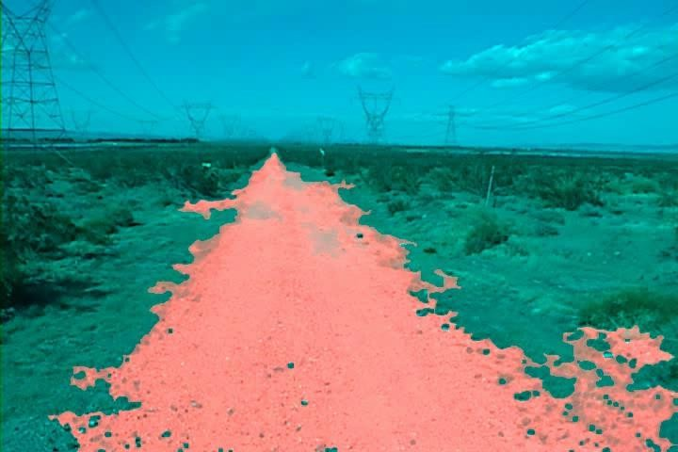
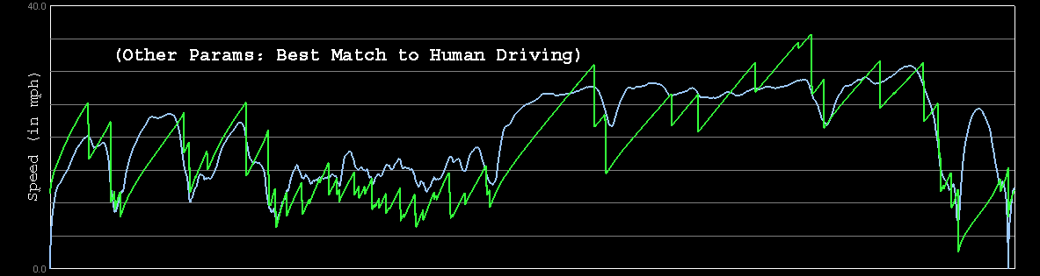
Autonomous Car Technology
Path Planning
Laser Terrain Mapping
Learning from Human Drivers
Adaptive Vision
Sebastian
Stanley

Slide 13

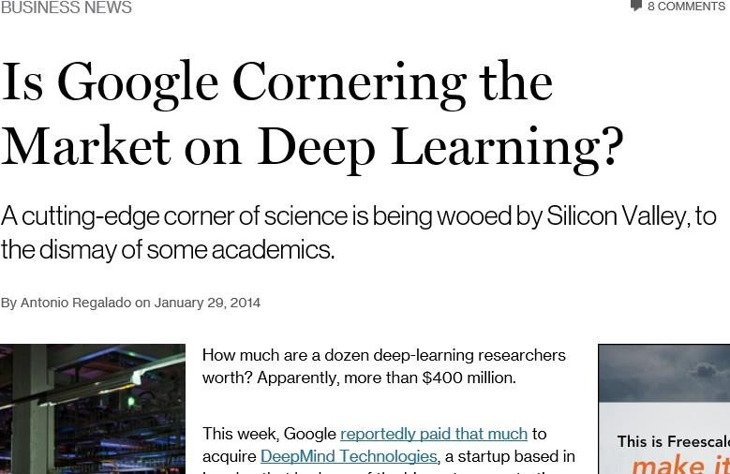

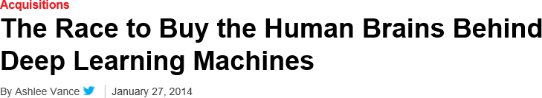
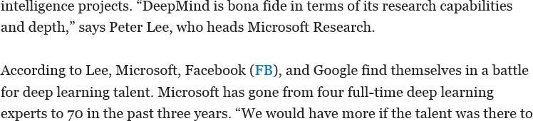
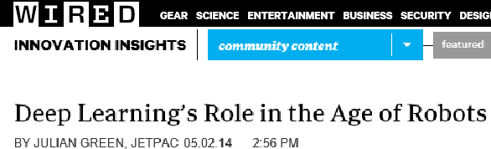
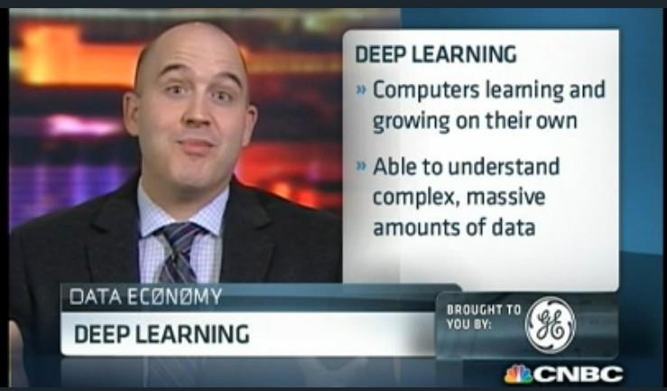
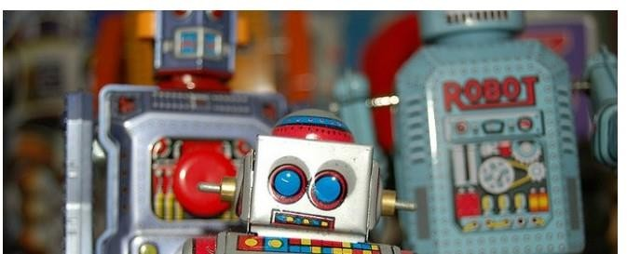
Deep Learning in the Headlines
15

Slide 14
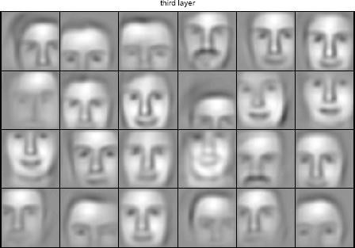
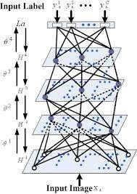

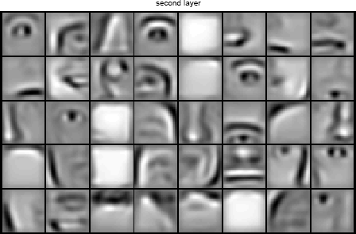


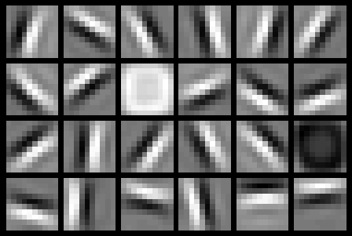
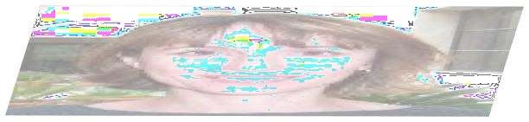



Deep Belief Net on Face Images
object models
object parts (combination of edges)
edges
pixels
16

Slide 15
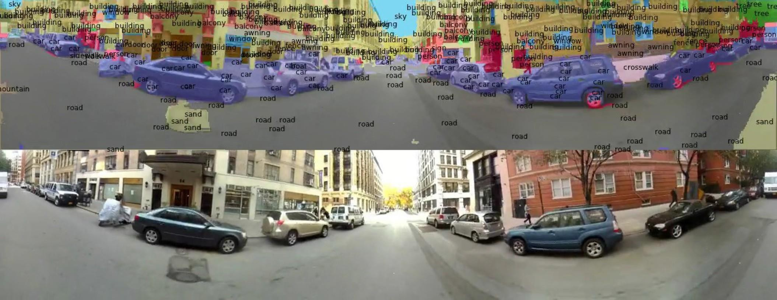
Scene Labeling via Deep Learning
19

Slide 16
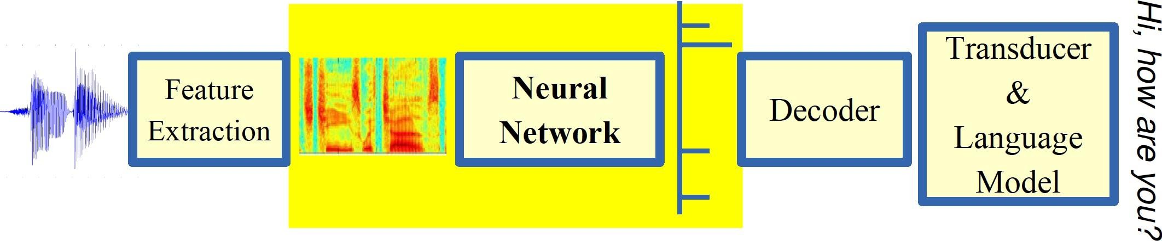
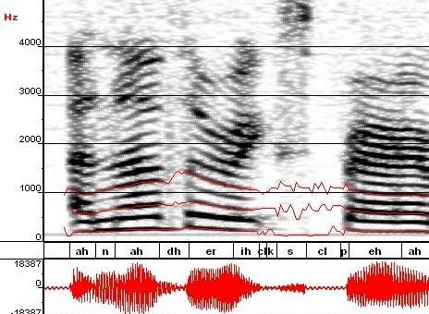
Machine Learning in Automatic Speech Recognition
A Typical Speech Recognition System
ML used to predict of phone states from the sound spectrogram
Deep learning has state-of-the-art results
# Hidden Layers | 1 | 2 | 4 | 8 | 10 | 12
Word Error Rate % | 16.0 | 12.8 | 11.4 | 10.9 | 11.0 | 11.1
Baseline GMM performance = 15.4%
[Zeiler et al. “On rectified linear units for speech
recognition” ICASSP 2013]
21

Slide 17
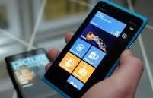
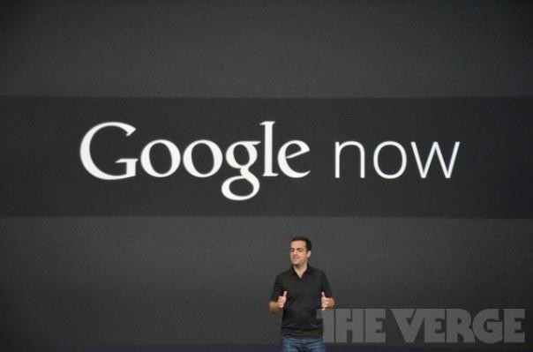

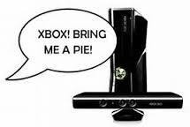


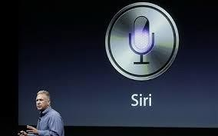
Impact of Deep Learning in Speech Technology
22

Slide 18
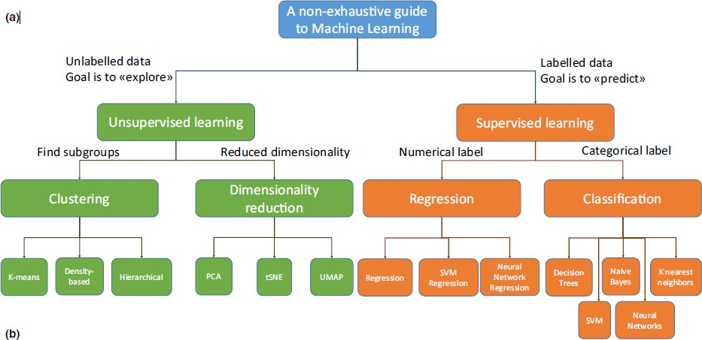

Slide 19
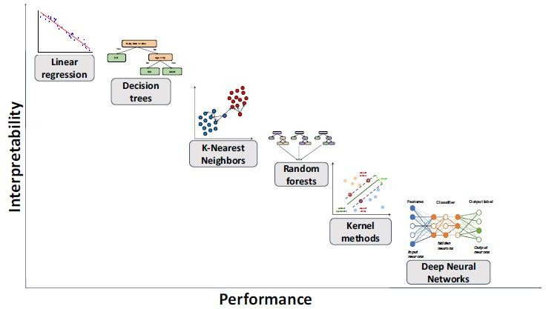
ML Techniques

Slide 20
Types of Learning
Supervised (inductive) learning
Given: training data + desired outputs (labels)
Unsupervised learning
Given: training data (without desired outputs)
Semi-supervised learning
Given: training data + a few desired outputs
Reinforcement learning
Rewards from sequence of actions
24

Slide 21
Supervised machine learning (Definition)
Supervised machine learning is a subfield of artificial intelligence (AI) and machine learning in which algorithms are trained to learn patterns and relationships within labeled data.
In supervised learning, the algorithm is provided with a dataset that consists of input-output pairs, where each input (also known as a feature or attribute) is associated with a corresponding output (also called a label or target).
The primary goal of supervised learning is to learn a mapping or function that can predict the output accurately for new, unseen input data.

Slide 22
Supervised machine learning (Steps)
Data Collection:
The process begins with the collection of a labeled dataset. This dataset is prepared by experts or generated through observations, experiments, or other means.
Data Preprocessing:
Before training a model, the dataset often undergoes preprocessing steps, which can include cleaning, normalization,
and feature engineering.
Training:
During the training phase, the machine learning algorithm takes the labeled dataset and learns a mapping from input features to output labels. The algorithm iteratively adjusts its internal parameters to minimize the difference between its predictions and the actual labels in the training data.
Model Evaluation:
After training, the model's performance is evaluated using a separate dataset called the validation or test set, which it has not seen during training.
Model Tuning:
If the model's performance is not satisfactory, hyperparameters may be adjusted, or the model's architecture may be modified. This process is known as hyperparameter tuning and is performed to improve the model's performance.
Prediction:
Once the model is trained and validated, it can be used for making predictions or classifications on new, unlabeled
data. The model takes the input features and produces predictions or labels based on the learned mapping.

Slide 23
Supervised machine learning (Examples)
Email Spam Classification: Classifying emails as either spam or not spam based on their content
and features.
Medical Diagnosis: Predicting whether a patient has a particular medical condition (e.g., diabetes) based on their medical history and test results.
Image Classification: Identifying objects in images (e.g., recognizing cats or dogs).
Credit Scoring: Assessing the creditworthiness of loan applicants based on financial and personal
information.
Language Translation: Translating text from one language to another.
Stock Price Prediction: Predicting future stock prices based on historical price and market data.

Slide 24
Unsupervised machine learning
Unsupervised machine learning is a branch of artificial intelligence (AI) and
machine learning where algorithms are trained to find patterns,
relationships, and structures within data that lacks explicit labels or categories.
Unlike supervised learning, unsupervised learning works with unlabeled
data, which means there are no predefined target outputs. Instead, the
algorithms aim to discover hidden patterns and structures within the data on their own.
Unsupervised machine learning is a valuable approach for uncovering
hidden patterns and structures within data when explicit labels or categories are unavailable.
It is widely used in exploratory data analysis, data preprocessing, and
various applications in fields such as clustering, dimensionality reduction, anomaly detection, and data visualization.

Slide 25
Unsupervised machine learning (Steps)
Data Input: Unsupervised learning begins with a dataset that consists of input features
only, without any associated output labels or categories. This data can take various
forms, such as text, numerical values, images, or any other type of unstructured or structured data.
Clustering: One of the primary tasks in unsupervised learning is clustering, where the
algorithm groups similar data points together based on their inherent similarities or
patterns. Clustering algorithms aim to identify natural groupings or clusters within the
data. Common clustering techniques include K-Means clustering, hierarchical clustering, and DBSCAN.
Dimensionality Reduction: Another key task in unsupervised learning is
dimensionality reduction. This involves reducing the number of features in the dataset
while preserving the essential information. Principal Component Analysis (PCA) and t-
Distributed Stochastic Neighbor Embedding (t-SNE) are common techniques used for dimensionality reduction.
Anomaly Detection: Unsupervised learning can also be used for anomaly detection,
where the algorithm identifies data points that deviate significantly from the expected
patterns or clusters. This is useful for detecting fraud, errors, or unusual behavior in various applications.

Slide 26
Unsupervised machine learning (Steps)
Anomaly Detection (Optional): If needed, use anomaly detection techniques to identify outliers or anomalies in the data. This can involve density-based methods like Gaussian Mixture Models (GMM) or isolation forests.
Association Rule Mining (Optional): Apply association rule mining algorithms like Apriori or FP-growth to discover interesting relationships between items or attributes in the data.
Data Visualization: Use visualization techniques to explore and interpret the results. Visualization can help in understanding the structure and patterns within the data.

Slide 27
Unsupervised machine learning (Steps)
Interpretation and Analysis: Analyze the results obtained from clustering, dimensionality reduction, or other techniques. Interpretation often involves understanding the meaning of clusters, anomalies, or associations in the context of the problem.
Validation and Evaluation (if applicable): In some cases, you may need to validate and evaluate the results using domain-specific metrics or criteria. For example, in clustering, you might use silhouette score or Davies-Bouldin index to assess the quality of clusters.
Decision-Making or Further Actions: Based on the insights gained from unsupervised learning, make data-driven decisions or take further actions. This could involve optimizing business processes, improving recommendations, or refining data preprocessing steps.

Slide 28
Unsupervised machine learning (Examples)
Customer Segmentation: Clustering customers into groups based on their purchase history and behavior.
Image Compression: Reducing the size of image files while preserving essential features.
Anomaly Detection in Network Security: Identifying unusual network traffic patterns that may indicate cyberattacks.
Topic Modeling: Discovering topics within a large collection of text documents, such as news articles or social media posts.
Recommendation Systems: Identifying patterns in user behavior to make personalized product or content recommendations

Slide 29
Semi-supervised learning
Semi-supervised learning is a machine learning paradigm that combines elements of both supervised and unsupervised learning. In semi-supervised learning, the algorithm is trained on a dataset that contains a mixture of labeled and unlabeled data.
This approach leverages the benefits of having access to limited labeled data while also harnessing the potentially vast amount of unlabeled data to improve model performance.
Semi-supervised learning allows you to make the most of the limited labeled data by leveraging a larger pool of unlabeled data, potentially leading to improved model performance and generalization.

Slide 30
Semi-supervised learning (Steps)
Data Collection: Collect a dataset that includes both labeled and unlabeled data. The labeled data should have input features along with their corresponding output labels, while the unlabeled data consists of input features only.
Data Preprocessing: Preprocess the data as needed, including cleaning, feature
engineering, and scaling, to prepare it for training.
Supervised Training: Train a machine learning model using the available labeled data. This step is similar to traditional supervised learning, where the algorithm learns to make predictions based on labeled examples.
Semi-supervised Training: Incorporate the unlabeled data into the training process. This can be done in various ways, such as using the model's predictions on unlabeled data as pseudo-labels or by leveraging techniques like self-training or co-training.
Model Evaluation: Evaluate the model's performance using appropriate metrics and a separate validation or test dataset that contains labeled data. This step helps assess how well the model generalizes to new, unseen data.
Iterative Refinement (Optional): Depending on the results, you may iteratively refine the model by adjusting hyperparameters, adding more labeled data, or updating the semi-supervised training process.

Slide 31
Semi- Supervised machine learning (Examples)
Text Classification for Sentiment Analysis: Suppose you have a small labeled dataset of customer
reviews with sentiment labels (positive, negative, neutral) and a large set of unlabeled reviews. You
can use semi-supervised learning to improve sentiment analysis by combining the labeled data with the unlabeled data and training a model to predict sentiment labels for the unlabeled reviews.
Image Classification with Limited Labels: In medical imaging, obtaining labeled data for rare diseases or specific medical conditions can be challenging. You may have a few labeled medical images but a vast collection of unlabeled images. Semi-supervised learning can help in training models to identify rare conditions by leveraging the unlabeled data.
Speaker Identification in Audio: When building a speaker identification system, you might have a small set of labeled audio recordings of specific speakers and a large set of unlabeled audio data. Semi-supervised learning can assist in recognizing and labeling speakers in the unlabeled data, thus improving the accuracy of the speaker identification system.
Document Categorization: In document categorization tasks, such as organizing news articles into topics or classifying legal documents, you may have a limited number of labeled documents. By using semi-supervised learning, you can categorize a larger corpus of unlabeled documents by leveraging the labeled examples.
Fraud Detection: Detecting fraudulent activities, such as credit card fraud, often relies on a small number of known fraud cases (labeled) and a large number of legitimate transactions (unlabeled). Semi-supervised learning can help improve fraud detection algorithms by identifying potentially suspicious patterns in the unlabeled transactions

Slide 32
Semi- Supervised machine learning (Examples)
Part-of-Speech Tagging in Natural Language Processing: In NLP tasks like part-of-
speech tagging, you might have a small dataset of annotated sentences but a
massive amount of unlabeled text. Semi-supervised learning can be used to train
part-of-speech taggers by combining labeled sentences with predictions on unlabeled text.
Image Segmentation: Image segmentation involves dividing an image into
regions of interest. In medical imaging, you might have a few segmented images
and a large dataset of unsegmented images. Semi-supervised learning can help automate the segmentation process by leveraging the unlabeled data.
Recommendation Systems: Recommender systems often benefit from both
explicit user ratings (labeled data) and implicit user behavior (unlabeled data).
Semi-supervised learning can enhance recommendation algorithms by combining both types of information to make more personalized recommendations.
Human Pose Estimation: In computer vision, estimating the poses of people in
images or videos can be improved with semi-supervised learning. You may have
annotated images with poses (labeled) and unlabeled images. Semi-supervised approaches can enhance pose estimation by leveraging the unlabeled data.

Slide 33
Reinforcement learning (RL)
Reinforcement learning (RL) is a machine learning paradigm where an agent learns to make sequences of decisions in an environment to maximize a cumulative reward signal.
Unlike supervised learning, where the algorithm is trained on labeled data, and unsupervised learning, where the goal is to find patterns in unlabeled data, RL focuses on learning optimal behaviors through interaction with an environment.

Slide 34
The key components of reinforcement learning
Agent: The learner or decision-maker that interacts with the environment. The agent takes actions to achieve specific goals.
Environment: The external system with which the agent interacts. It provides feedback to the agent based on the agent's actions.
State (s): A representation of the current situation or configuration of the
environment. The state provides information about the environment's status.
Action (a): The choices made by the agent at each time step to influence
the environment. Actions can be discrete (e.g., selecting from a set of predefined actions) or continuous (e.g., controlling a robot's motor speed).
Reward (r): A scalar value that provides feedback to the agent after each
action, indicating how good or bad the action was in achieving the agent's
goals. The agent's objective is to maximize the cumulative reward over time.

Slide 35
Reinforcement learning (Steps)
Initialization: Initialize the agent's policy (strategy) and value function. The policy
defines how the agent selects actions, and the value function estimates the expected cumulative reward for being in a particular state and following the policy.
Interaction with Environment: The agent interacts with the environment by taking
actions based on its current policy. At each time step, the agent observes the current state, selects an action, and receives a reward from the environment.
Policy Update: The agent updates its policy based on the observed rewards and
states. The goal is to improve the policy over time to maximize the cumulative
reward. Different RL algorithms use various techniques to update the policy,
including value iteration, policy iteration, Q-learning, and deep reinforcement
learning using neural networks.
Exploration vs. Exploitation: The agent faces a trade-off between exploring new
actions to learn better policies (exploration) and exploiting its current knowledge to
maximize short-term rewards (exploitation). Balancing exploration and exploitation
is a crucial challenge in reinforcement learning.
Learning Rate and Discount Factor: Reinforcement learning algorithms often use a
learning rate to control how much the agent updates its policy based on new
experiences. A discount factor is used to balance immediate rewards against future rewards, allowing the agent to consider long-term consequences.

Slide 36
Thank You

